Slide 1
MANCOSA
INTERNAL COMMUNICATION SYSTEM

Slide 2

ABOUT THE COMPANY
The Management College of Southern Africa (MANCOSA) is a private higher education institution registered in terms of the Higher Education Act (Act 101 of 1997 as amended). It was established in 1995 as a post-apartheid empowerment institution offering affordable and accessible management education primarily to persons previously denied access to postgraduate education. MANCOSA has 100% black ownership, i.e. it is owned entirely by previously disadvantaged individuals in the South African context. MANCOSA has extensive experience in working with a wide range of students over the past 20 years in delivering high quality management and education programmes offered locally and internationally. The Master of Business Administration (MBA) degree programme has been offered since 1995.

Slide 3

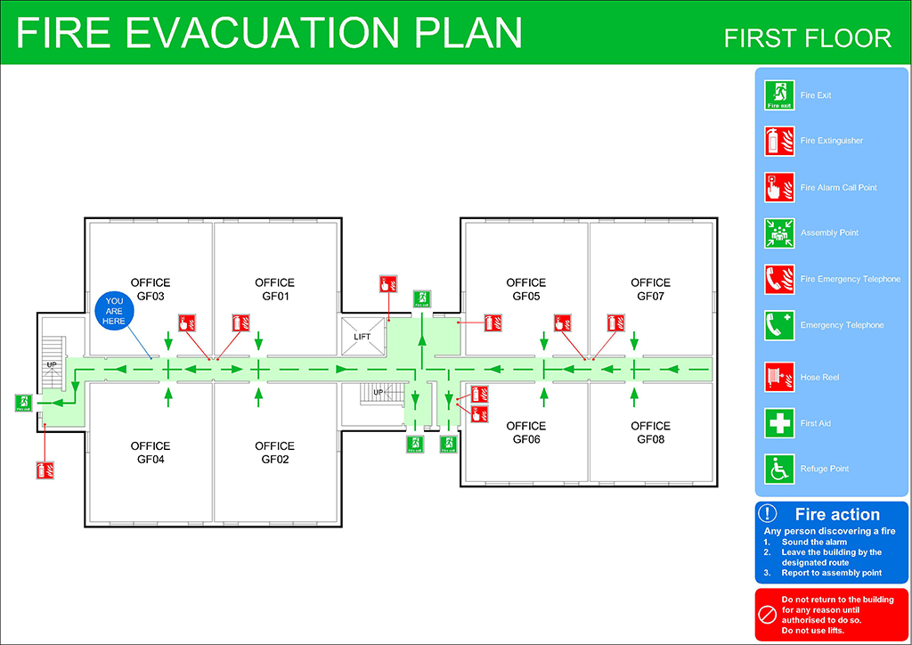
SYSTEM REQUIREMENTS
ACCESS TO CONTACTS
View contact details
EMERGENCY
Floor plan
Emergency contact
Alert button

Slide 4


SYSTEM REQUIREMENTS Cont.
LUNCH SERVICES
Cafeteria
Order lunch
Lunch time slots
IT SERVICES
Issue logs
Complaints

Slide 5
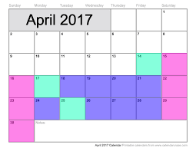

SYSTEM REQUIREMENTS Cont.
LEAVE & ABSENTEEISM
Leave days
Absent staff
Application for leave
EVENT MANAGEMENT
Calendar
Upcoming events
Event organising

Slide 6
SCREENSHOTS

Slide 7
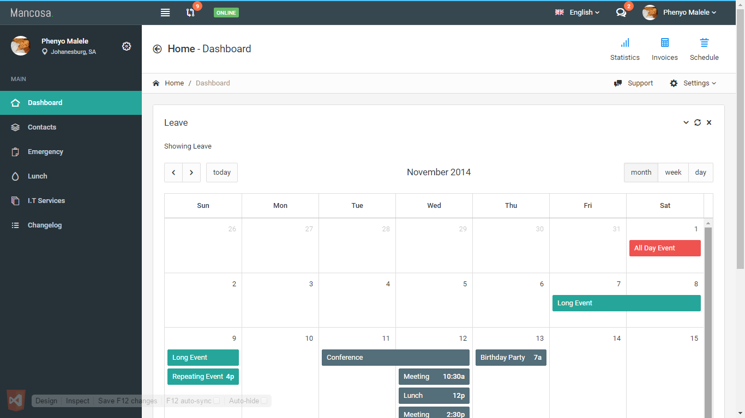

Slide 8


Slide 9
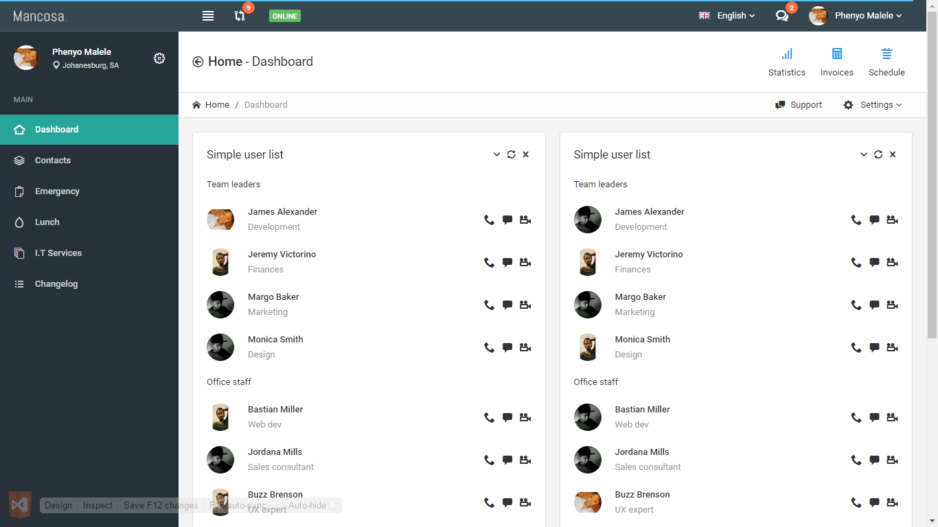

Slide 10
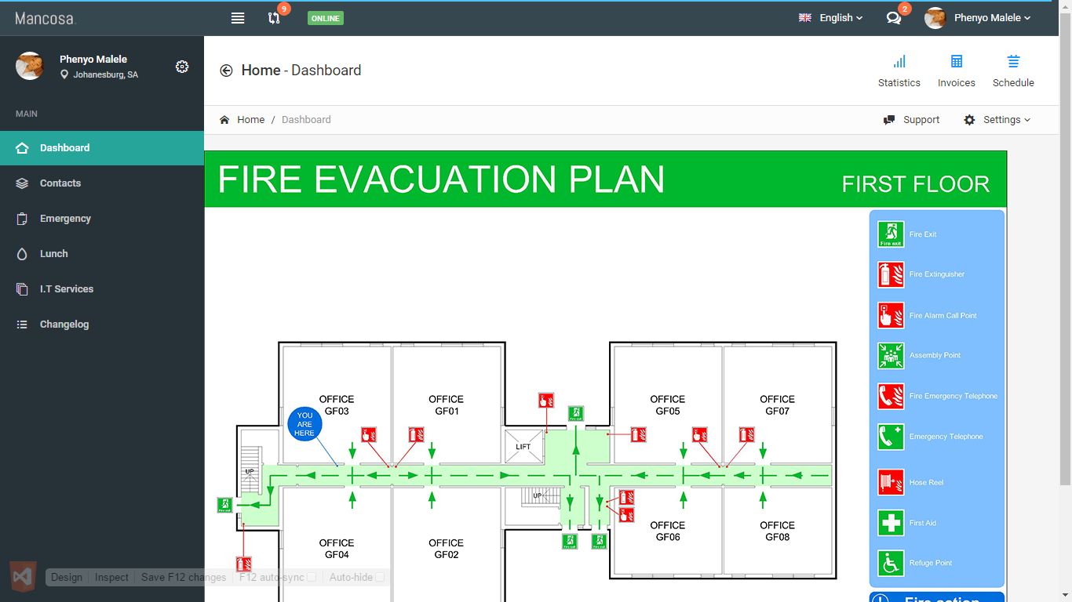

Slide 11
